Slide 1
Circuit Theory
Chapter 11
AC Power Analysis
Copyright © The McGraw-Hill Companies, Inc. Permission required for reproduction or display.

Slide 2
AC Power Analysis
Chapter 11
11.1 Instantaneous and Average Power
11.2 Maximum Average Power Transfer
11.3 Effective or RMS Value
11.4 Apparent Power and Power Factor
11.5 Complex Power
11.6 Conservation of AC Power
11.7 Power Factor Correction
11.8 Power Measurement

Slide 3
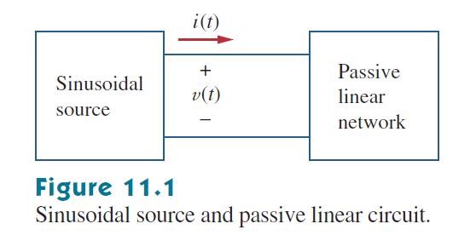
11.1 Instantaneous and Average Power (1)

Slide 4
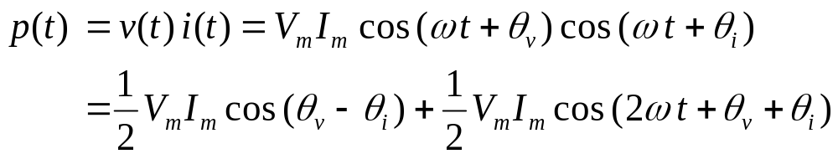
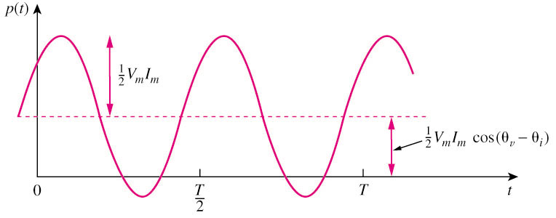
11.1 Instantaneous and Average Power (1)
The instantaneous power, p(t)
Constant power
Sinusoidal power at 2ωt
p(t) > 0: power is absorbed by the circuit; p(t) < 0: power is absorbed by the source.

Slide 5
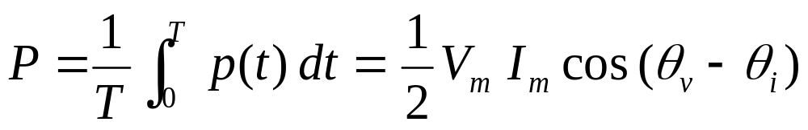
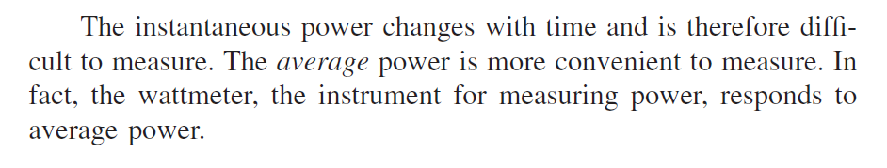
11.1 Instantaneous and Average Power (2)
The average power, P, is the average of the instantaneous power over one period.
  P is not time dependent.
  When θ_{v} = θ_{i} , it is a purely resistive load case.
  When θ_{v}– θ_{i} = ±90o, it is a purely reactive load case.
  P = 0 means that the circuit absorbs no average power.

Slide 6

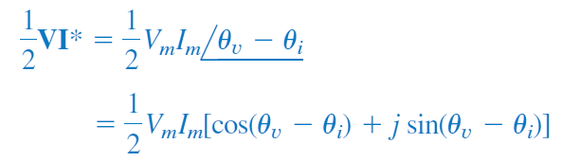
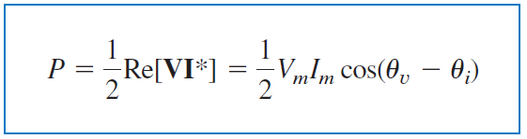
11.1 Instantaneous and Average Power (2)
We can find P in time domain as well as in Phasor Domain.

Slide 7
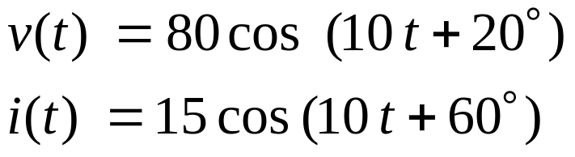
11.1 Instantaneous and Average Power (3)
Example 1
Calculate the instantaneous power and average power absorbed by a passive linear network if:

Slide 8


11.1 Instantaneous and Average Power (4)
Example 2
A current flows through an impedance . Find the average power delivered to the impedance.
Answer: 927.2W

Slide 9
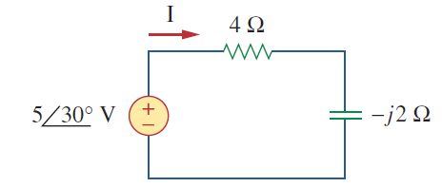
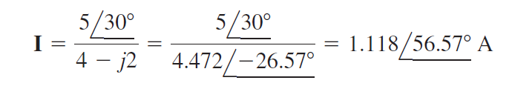
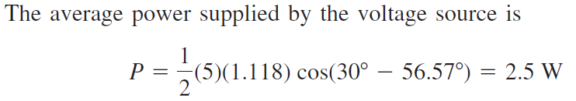
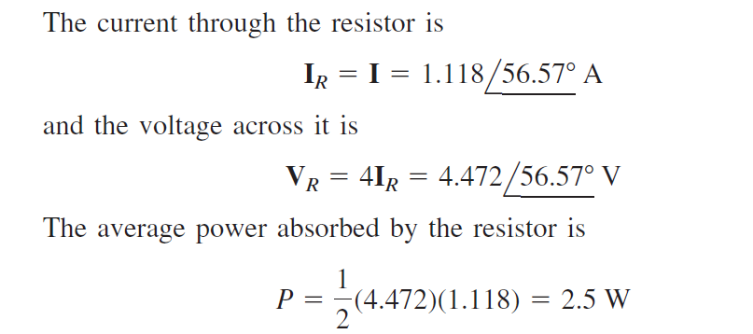
11.1 Instantaneous and Average Power (5)
Example 3

Slide 10
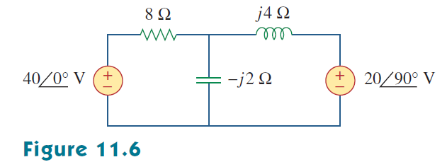
11.1 Instantaneous and Average Power (6)
Example 4

Slide 11
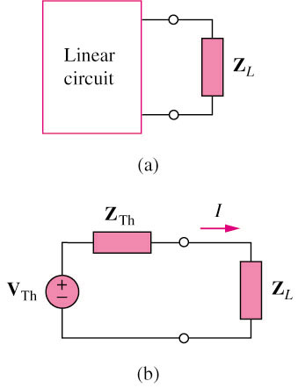


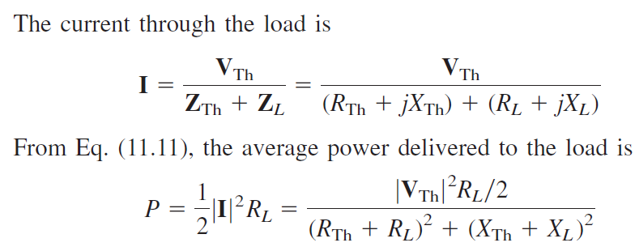
11.2 Maximum Average Power Transfer (1)

Slide 12

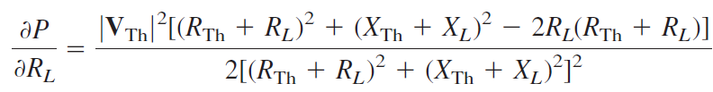
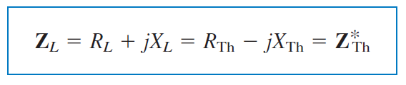
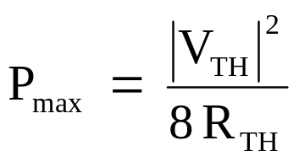

11.2 Maximum Average Power Transfer (2)
The maximum average power can be transferred to the load if
X_{L} = –X_{TH} and R_{L} = R_{TH}
If the load is purely real, then

Slide 13
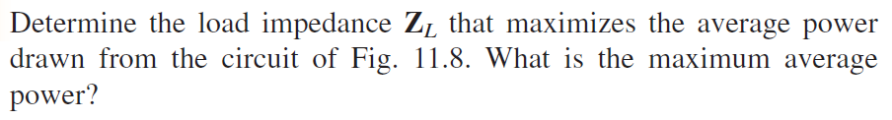
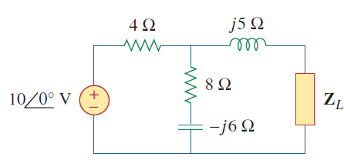
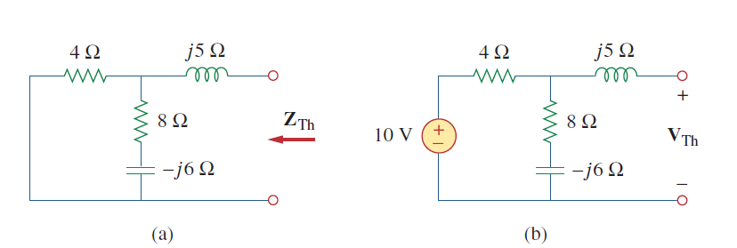
Example 11.5

Slide 14

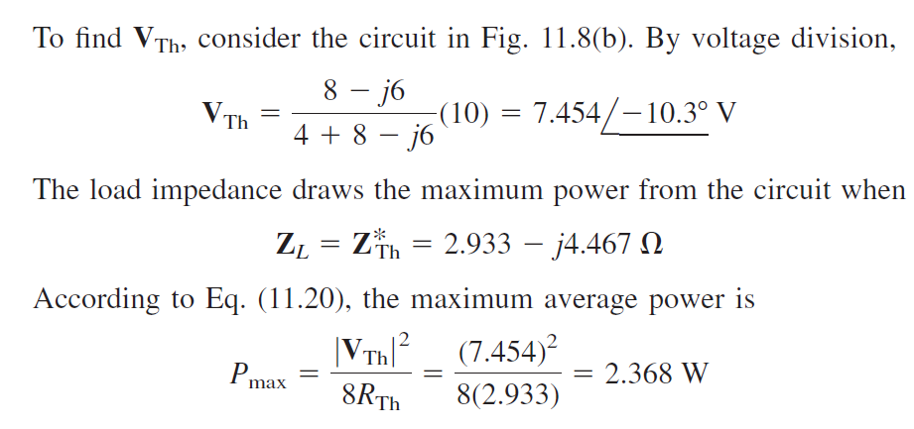
Example 11.5

Slide 15
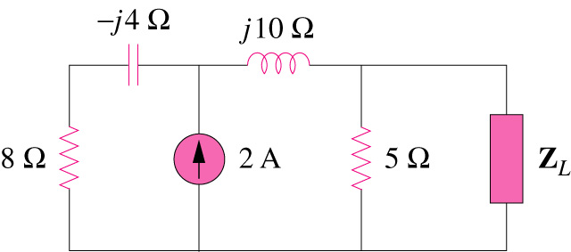
11.2 Maximum Average Power Transfer (2)
Example 3
For the circuit shown below, find the load impedance Z_{L} that absorbs the maximum average power. Calculate that maximum average power.
Answer: 3.415 – j0.7317Ω, 1.429W

Slide 16
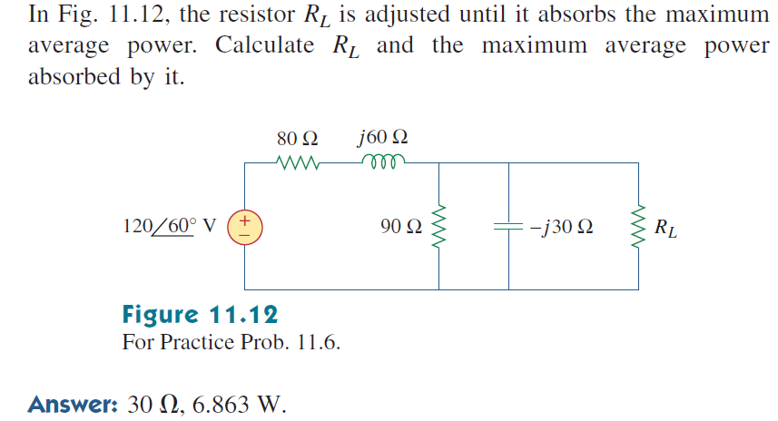
Practice Problem

Slide 17
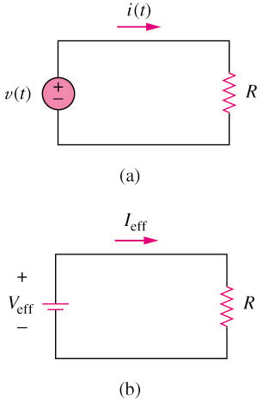
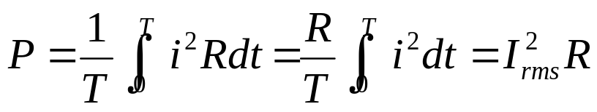
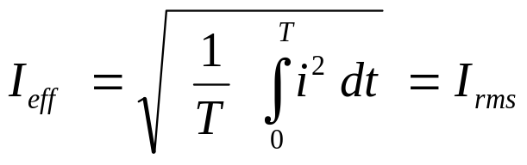
11.3 Effective or RMS Value (1)
  The total power dissipated by R is given by:
Hence, I_{eff} is equal to:
The rms value is a constant itself which depending on the shape of the function i(t).
  The effective of a periodic current is the dc current that delivers the same average power to a resistor as the periodic current.

Slide 18
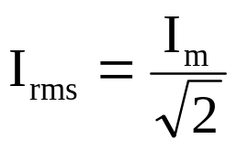
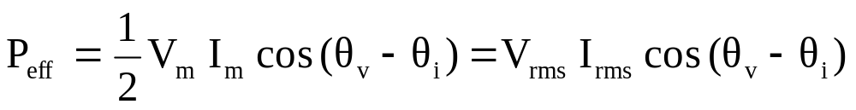
11.3 Effective or RMS Value (2)
  The rms value of a sinusoid i(t) = I_{m}cos(ωt) is given by:
The average power can be written in terms of the rms values:
  Note: If you express amplitude of a phasor source(s) in rms, then all the answer as a result of this phasor source(s) must also be in rms value.

Slide 19
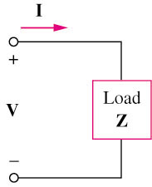
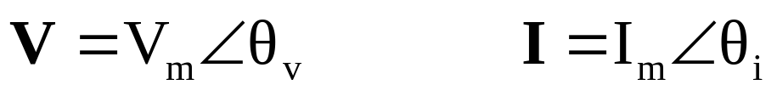
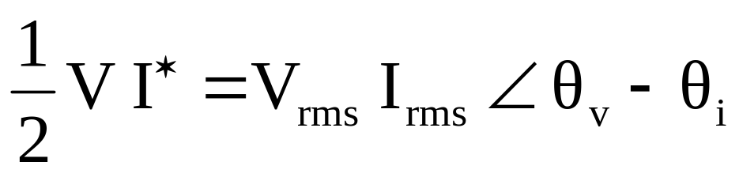
11.5 Complex Power (1)
Complex power contains all info pertaining to the power absorbed by the load.
Complex power S is the product of the voltage and the complex conjugate of the current:
HW11 Ch 11: 1, 5, 15, 27, 95

Slide 20
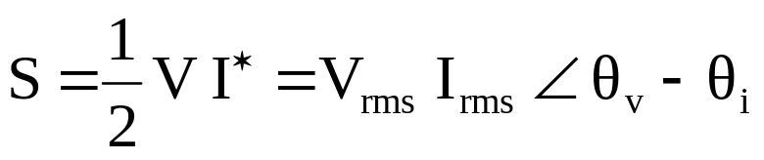
11.5 Complex Power (VA) (2)
S = P + j Q
P: is the average power in watts delivered to a load and it is
the only useful power.
Q: is the reactive power exchange between the source and
the reactive part of the load. It is measured in VAR.
    Q = 0 for resistive loads (unity pf).
    Q < 0 for capacitive loads (leading pf).
    Q > 0 for inductive loads (lagging pf).

Slide 21
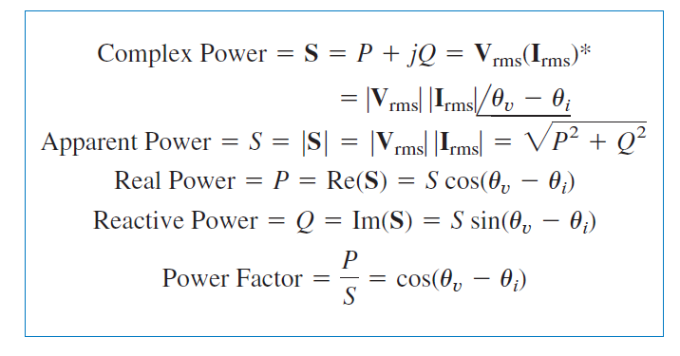
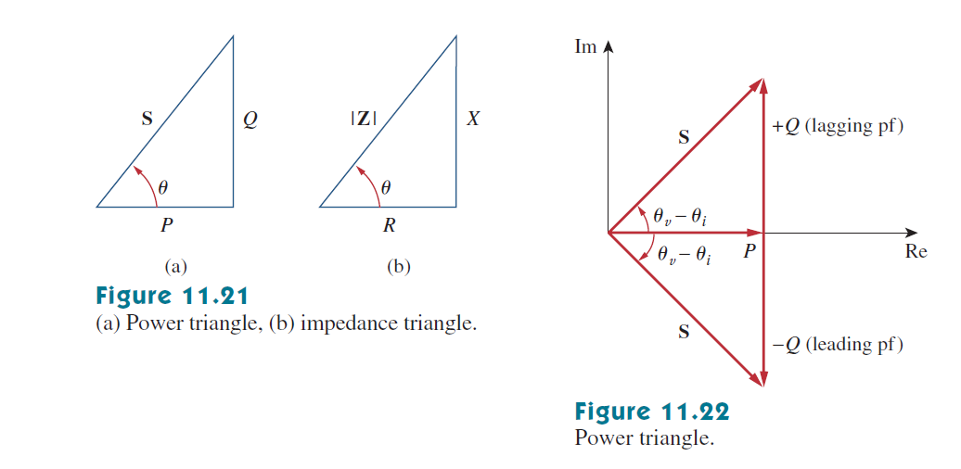
11.5 Complex Power (3)

Slide 22
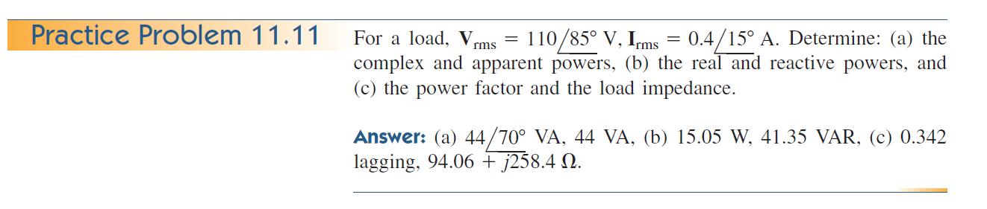
Example

Slide 23
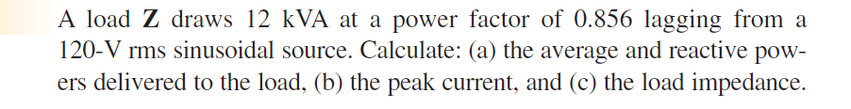
Example

Slide 24

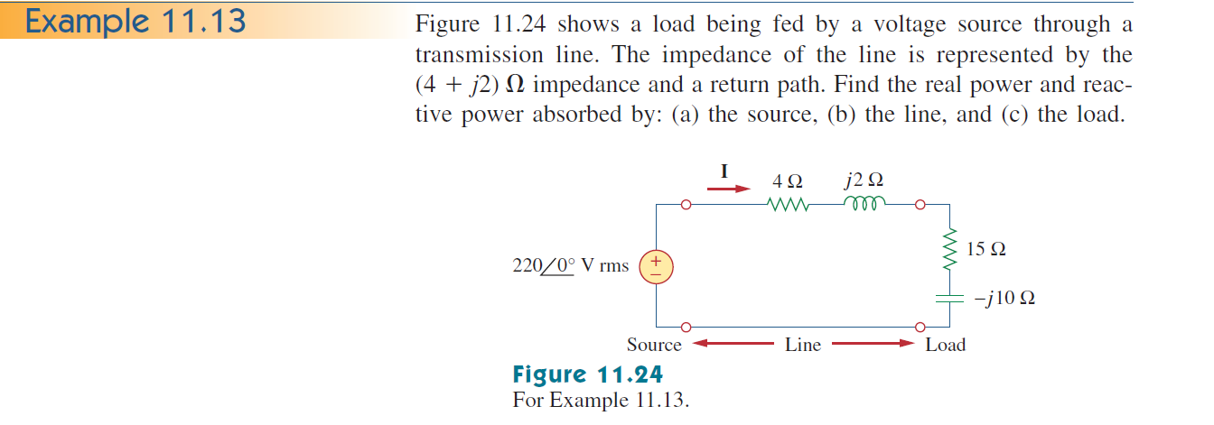
Conservation of AC power
All forms of AC power are conserved: Instantaneous, real, reactive and Complex

Slide 25

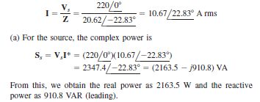
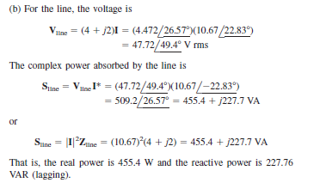
Example (1)

Slide 26
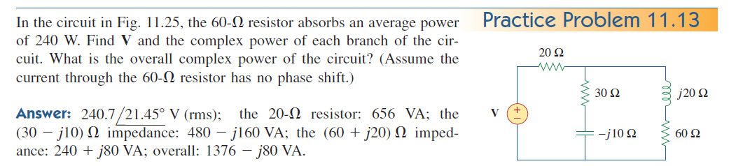
Practice Problem

Slide 27

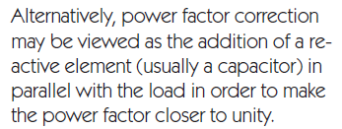
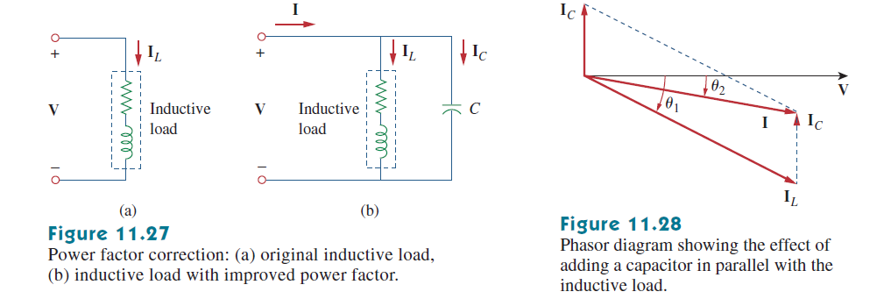
Power Factor Correction

Slide 28
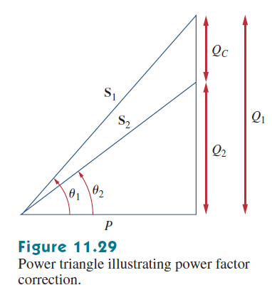

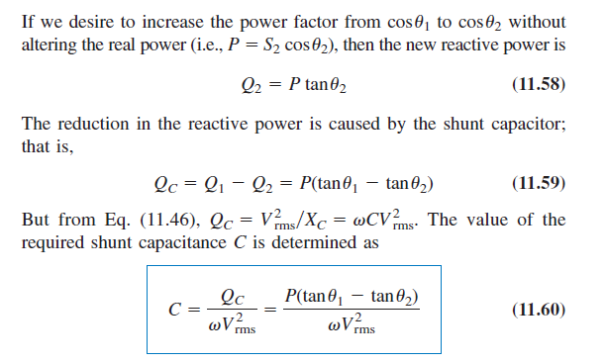
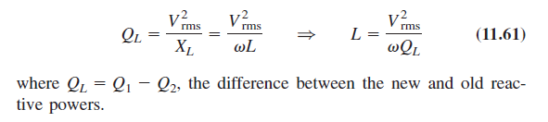
Power Factor Correction (1)

Slide 29
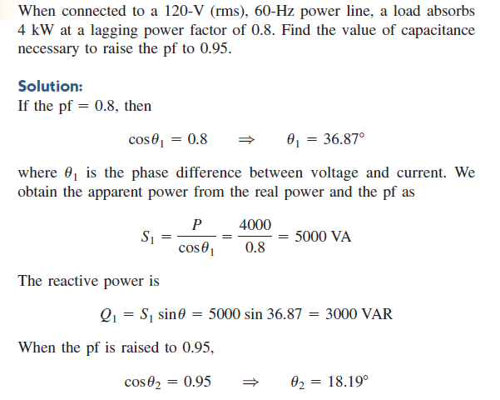
Example

Slide 30
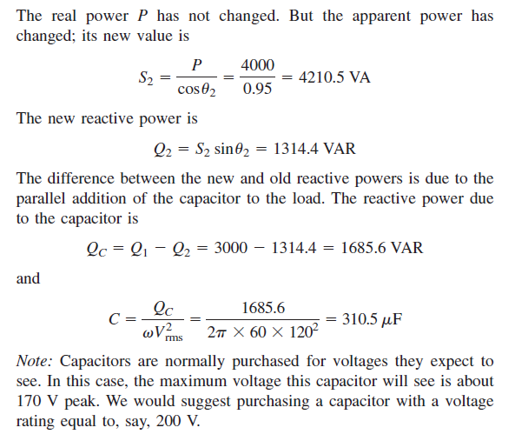
Example (1)

